Slide 1

Fraud detection
Viktor Welbers

Slide 2
AGENDA
Data OverVIEW, analysis and Transformation
Model implementation and Test Set Review
Results

Slide 3

Data Overview: First Impressions
11 initial features and a binary target: OK / FRAUD
Dataset consists of 26398 samples
Deep Learning is not suitable for this problem due to the low amount of data
Suitable algorithms are: GBDT, Random Forest or other classical ML-Algorithms
The target is highly imbalanced, which needs to be considered in the process

Slide 4
Data Analysis: Approach
Data-Driven approach without the use of domain-knowledge:
No pre-selection of features based on expert knowledge
Use of feature selection methods and data cleaning to reduce the number of features
Selection of LightGBM due to efficiency and performance for datasets of similar size.
Advantage: A LightGBM model can utilize a GPU in training
No previous scaling of features is needed for this model, which enables it to be implemented quickly

Slide 5
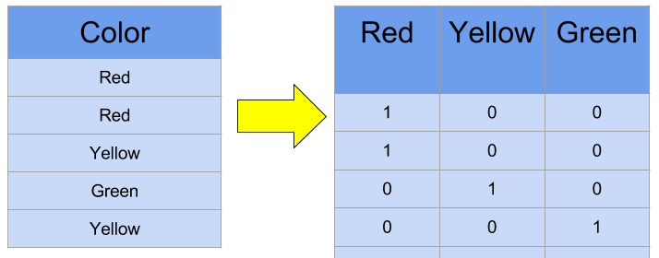
Data Transformation: Prepare dataset for ML
The data in its original form was not suitable for the use in a Machine Learning model
To make it usable for our use-case, different data transformation, encoding, deletion, and imputation techniques were used

Slide 6

Model Implementation: Methodology
92,5 % of listings are non fraudulent, which results in an imbalanced dataset:
Commonly used metrics (e.g., Accuracy) are less effective to estimate the performance
For imbalanced datasets, a metric like Area Under the Precision-Recall Curve is needed, which helps us to evaluate our model
Result: Reasonable estimate which helps to decide if the model can be utilized by the CS-Team
The tuning-library Optuna is used to optimize the Machine Learning model

Slide 7
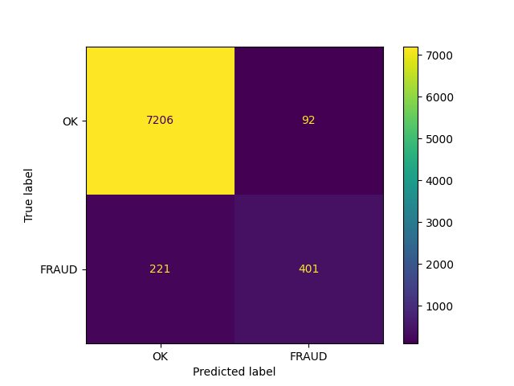
Model Implementation: Test set Review
401 Out of 622 FRAUD cases were correctly identified
Only 92 of 7298 listings, that were not-fraudulent were deemed as fraud
Overall Accuracy of 96.04%
A reasonable AURPC of 0.74

Slide 8

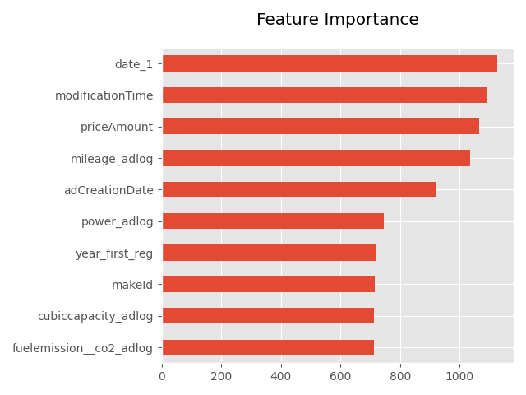
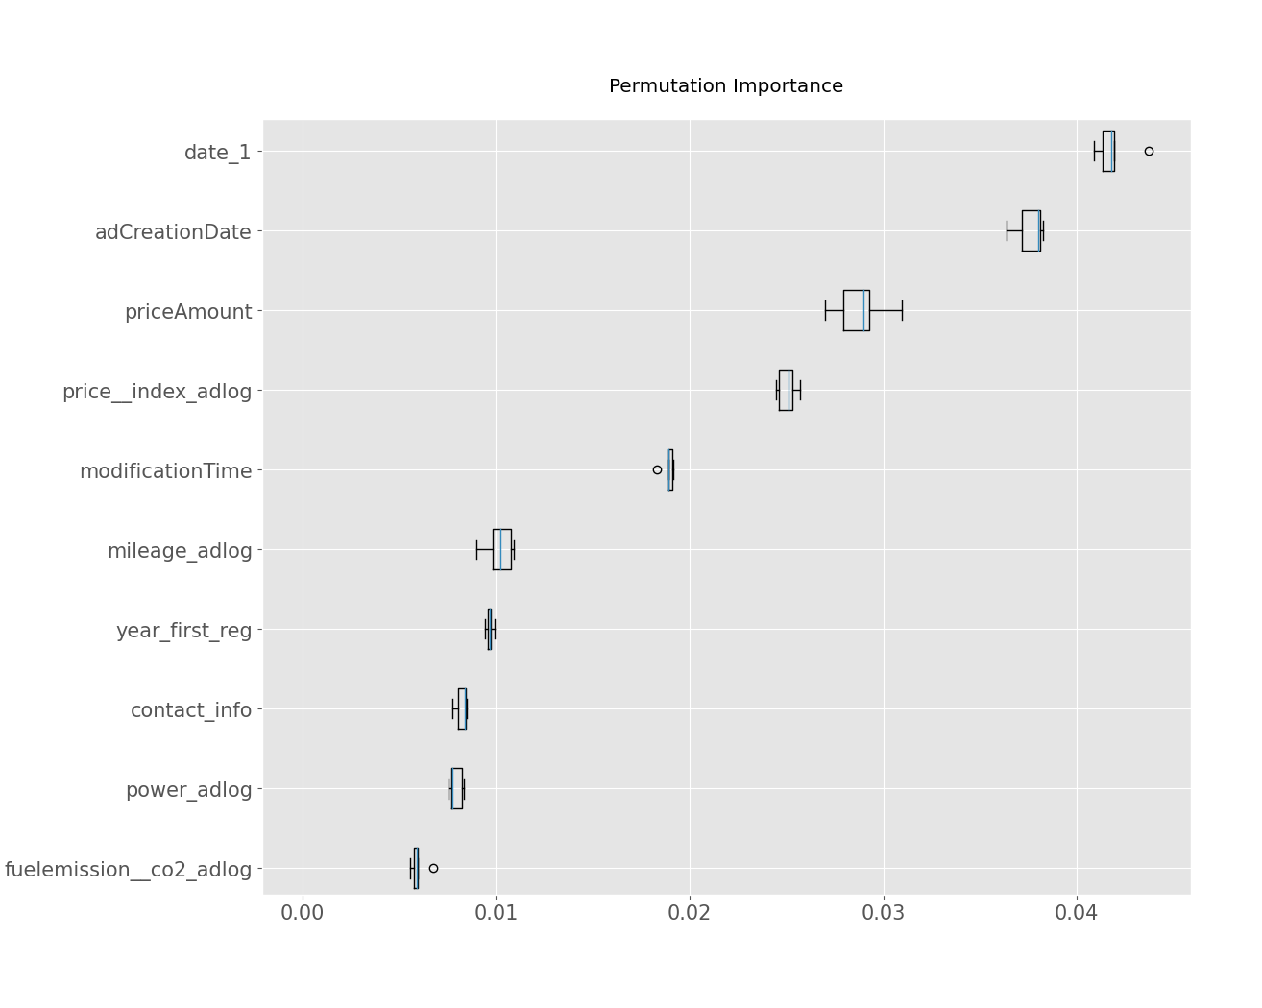
Results: What is most indicative of a fraudulent listing?
Date1 field not explained in detail. But the importance of it and modificationTime are difficult to explain via domain knowledge
Both priceAmount and mileage are possibly in line with domain knowledge.

Slide 9

Results: Is the model usable in production?
For mobile.de's business it is important to not assign fraud to legit listings:
Only 1.2% of legit listings were assigned as fraud (Test set)
It is obviously also important to find as many fraudulent listing as possible:
64% of all Fraud listings were correctly identified (Test set)
With some improvements (e.g., > 10 minutes of parameter tuning) the model could be a suitable choice for fully automated fraud detection
It is already useful in a half-automated approach, that proposes possible fraudulent listings to a human supervisor in the CS-Team.

Slide 10
Results: Summary
We used the data to train an efficient classical machine learning model
We transformed data to make it usable for the machine learning model
The focus was to be able to detect fraudulent cases, but to also have a low false positive rate, which would lead to a loss in customers and therefore revenue.
The main challenge was: Imbalanced Data!!!
With little to no tuning time, we created a suitable model, that could possibly be used in production

